Slide 1

L3 – Data Manipulation with Pandas

Slide 2
Read Carefully
For each week’s in-class exercises and/or homework, please create a new Jupyter notebook file with the following naming convention:
ID_Name_C(no.).ipynb
for example,
6619999_Johnwick_C3.ipynb

Slide 3
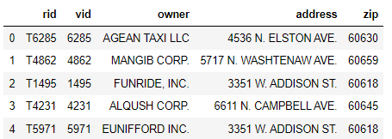
Data Loading – What is Pickle Files (.p or .pkl)?
Apart from .csv files, there are many other file formats that Pandas can read. For example,
Pickle is a serialized way of storing a Pandas dataframe. Basically, you are writing down the exact representation of the dataframe to disk. This means the types of the columns are and the indices are the same. Download taxi_owners.p and load the data using pd.read_pickle()
Today we will be trying Pickle files as well. Back to that soon
taxi_owner = pd.read_pickle('taxi_owners.p')
taxi_owner.head()

Slide 4
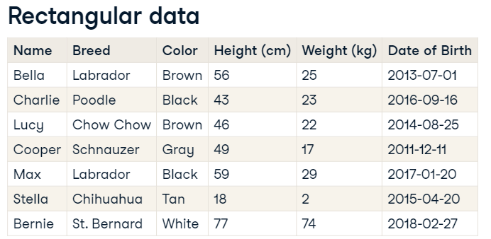
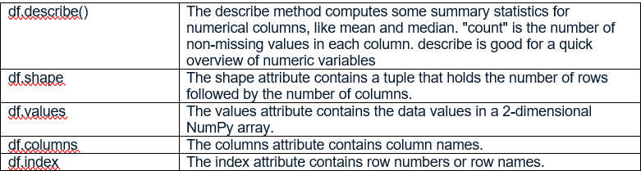
Basic Data Exploration
There are several ways to store data for analysis, but rectangular data, sometimes called "tabular data" is the most common form. In this example, with dogs, each observation, or each dog, is a row, and each variable, or each dog property, is a column.
Exploring a DataFrame can be done by many methods such as .head(), .info(). The .info() method displays the names of columns, the data types they contain, and whether they have any missing values.
Let’s load homelessness.csv to homelessness DataFrame and explore the data with above methods.

Slide 5
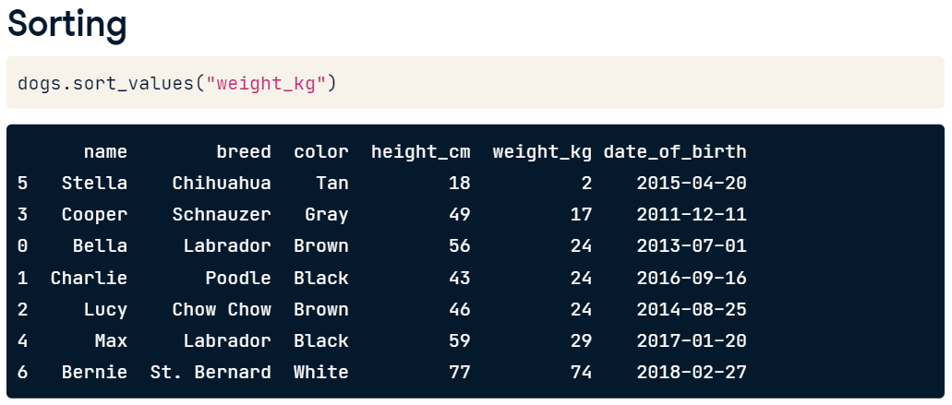
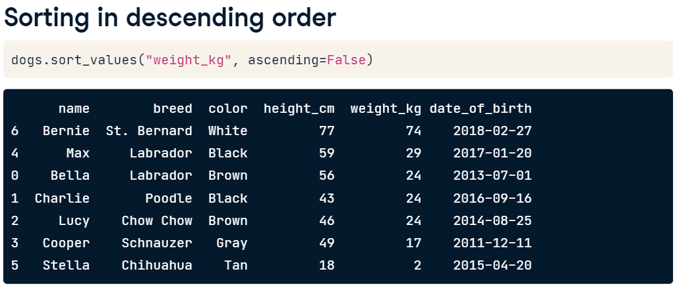
Sorting and Subnetting (Filtering)
Data can be sorted by a label. For example,
Setting the ascending argument to False will sort the data the other way around, from heaviest dog to lightest dog.

Slide 6
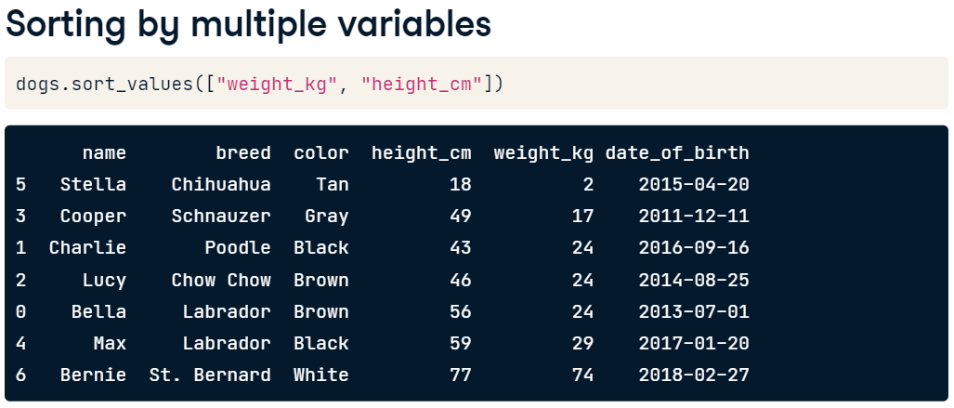
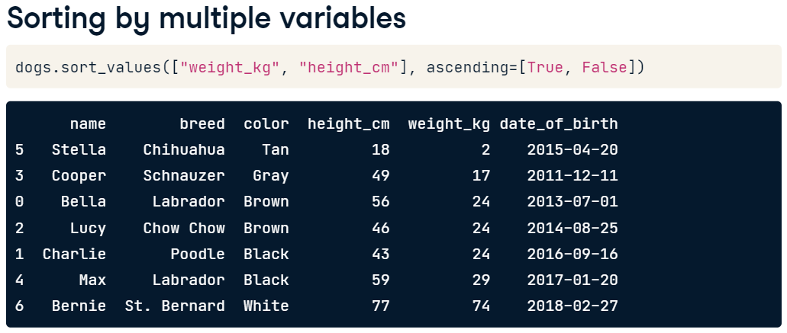
Sorting and Subnetting (cont.)
We can sort with multiple variables.
You need to pass a list of variables as an argument.
To change the direction values are sorted in, pass a list to the ascending argument to specify which direction sorting should be done for each variable.

Slide 7
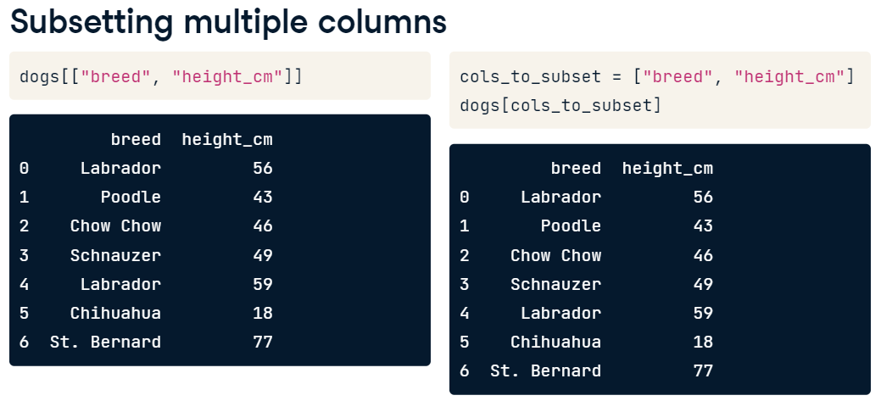
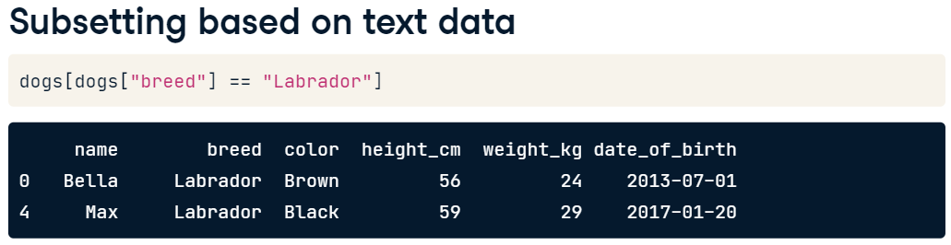
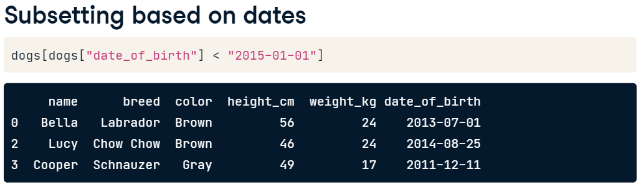
Subsetting Data
Selecting column(s) or subsetting column(s) can be done as follows.

Slide 8
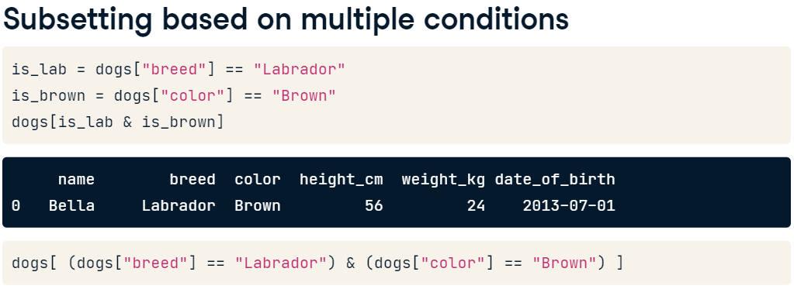
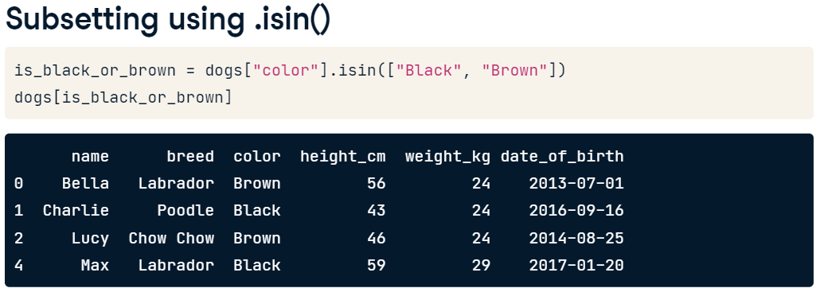

Slide 9
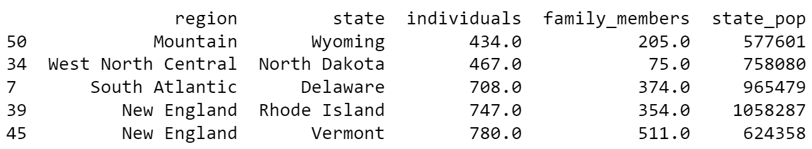
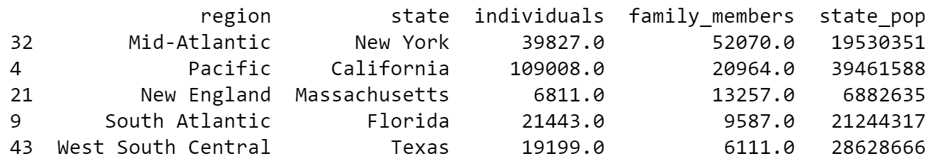
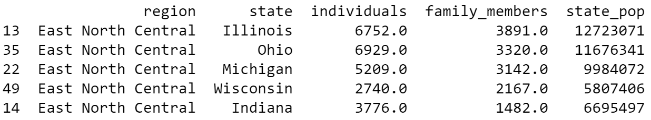
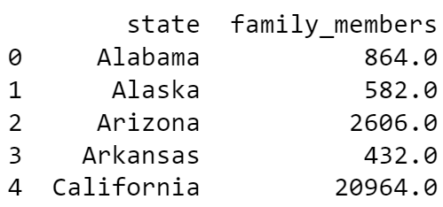
Let’s practice with homelessness DataFrame. Load homelessness.csv into homelessness DataFrame.
Sort homelessness by the number of homeless individuals, from smallest to largest, and save this as homelessness_ind. Print the head of the sorted DataFrame.
Sort homelessness by the number of homeless family_members in descending order, and save this as homelessness_fam. Print the head of the sorted DataFrame.
Sort homelessness first by region (ascending), and then by number of family members (descending). Save this as homelessness_reg_fam. Print the head of the sorted DataFrame.
Create a DataFrame called state_fam that contains only the state and family_members columns of homelessness, in that order. Print the head of the result.

Slide 10
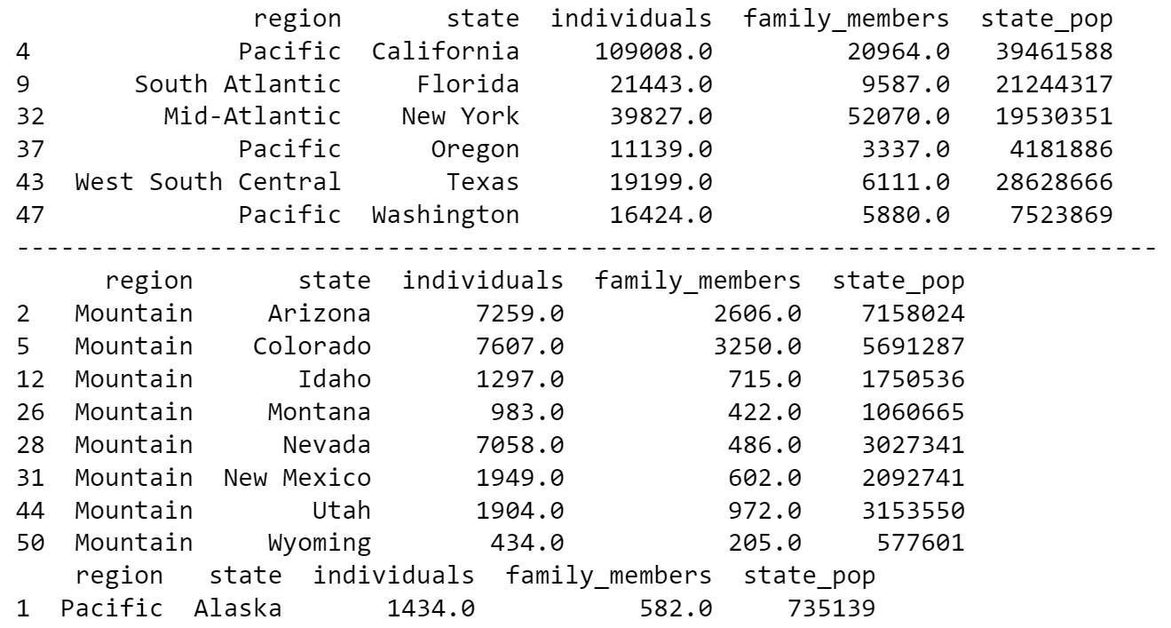
Let’s practice with homelessness DataFrame. Load homelessness.csv into homelessness DataFrame.
5. Filter homelessness for cases where the number of individuals is greater than ten thousand, assigning to ind_gt_10k. View the printed result.
6. Filter homelessness for cases where the USA Census region is "Mountain", assigning to mountain_reg. View the printed result.
7. Filter homelessness for cases where the number of family_members is less than one thousand and the region is "Pacific", assigning to fam_lt_1k_pac. View the printed result.
df[ conditions ] or df[(condition1) & (condition2)] # each condition must in put in a separate ( )
homelessness[homelessness[‘region’] == ‘Mountain’]
homeless_pop = homelessness[ homelessness[‘state_pop’ > 2000000]]

Slide 11
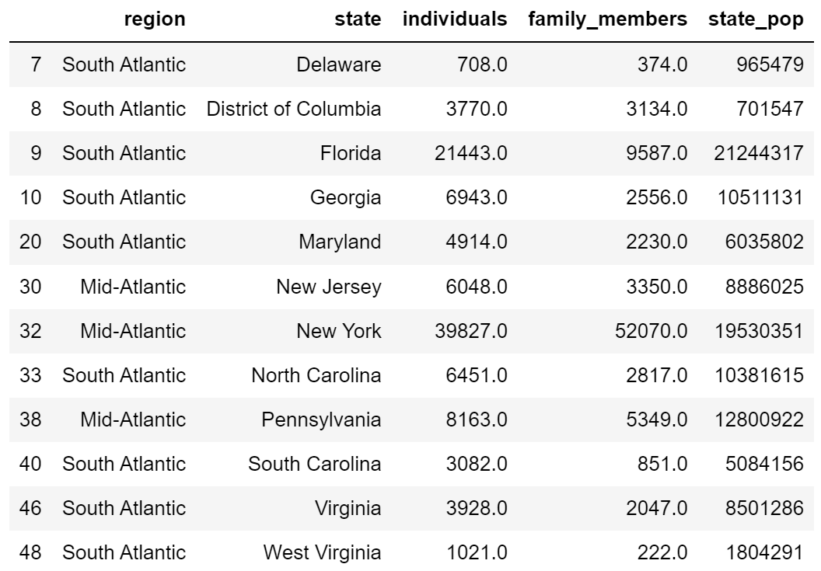
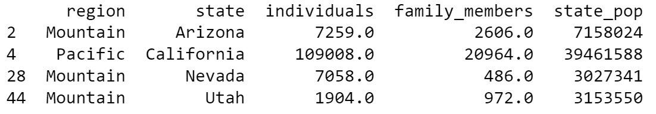
8. Filter homelessness for cases where the USA census region is "South Atlantic" or "Mid-Atlantic", assigning to south_mid_atlantic. View the printed result.
9. Filter homelessness for cases where the USA census state is in the list of Mojave states, canu, assigning to mojave_homelessness. View the printed result.

Slide 12
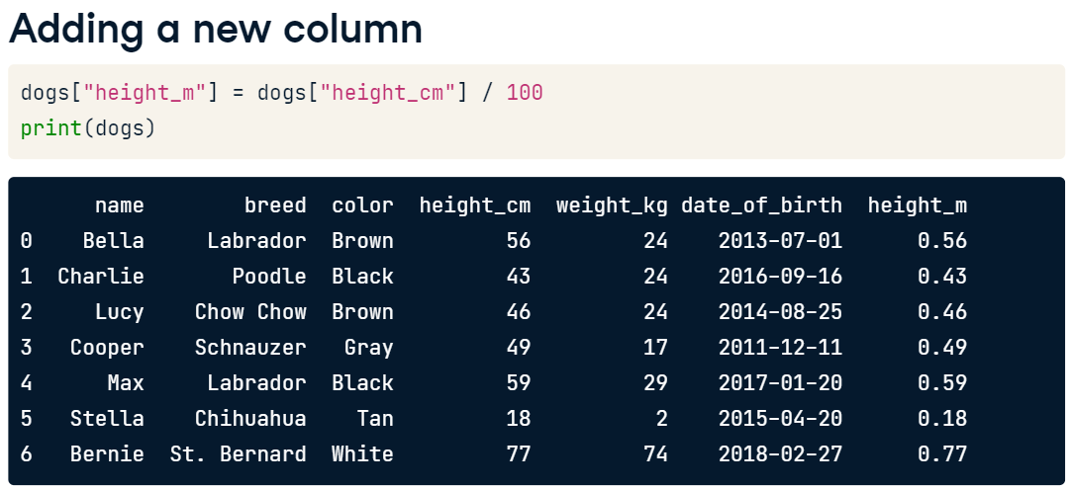
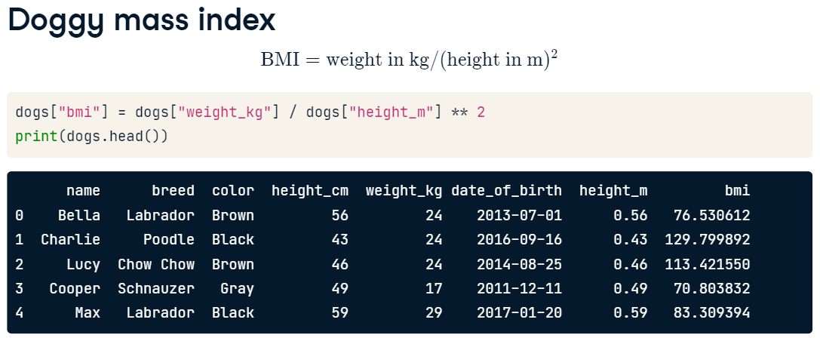
Adding a new column

Slide 13
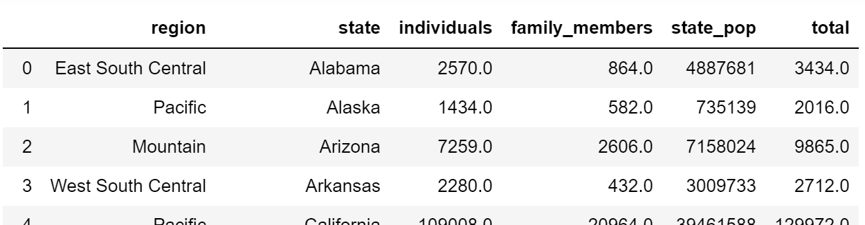
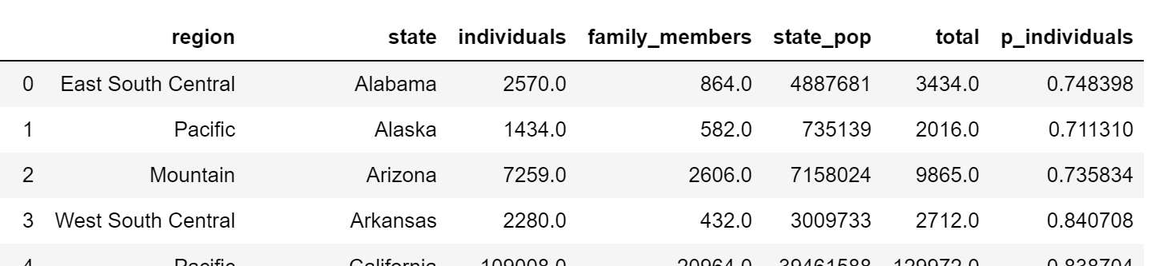
10. Add a new column to homelessness, named total, containing the sum of the individuals and family_members
columns. (Not all rows are shown. There should be 50 rows in total.)
11. Add another column to homelessness, named p_individuals, containing the proportion of homeless people in each state who are individuals.

Slide 14
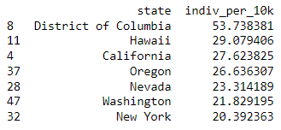
12. Combo Attack…..
Add a column to homelessness, indiv_per_10k, containing the number of homeless individuals per ten thousand people in each state.
Hint: 10000 * homelessness['individuals'] / homelessness['state_pop']
Subset rows where indiv_per_10k is higher than 20, assigning to high_homelessness.
Sort high_homelessness by descending indiv_per_10k, assigning to high_homelessness_srt.
Select only the state and indiv_per_10k columns of high_homelessness_srt and save a result. Look at the result.

Slide 15
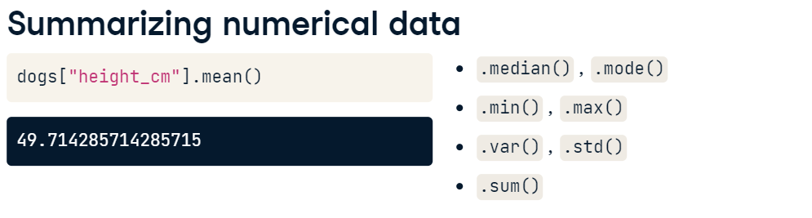
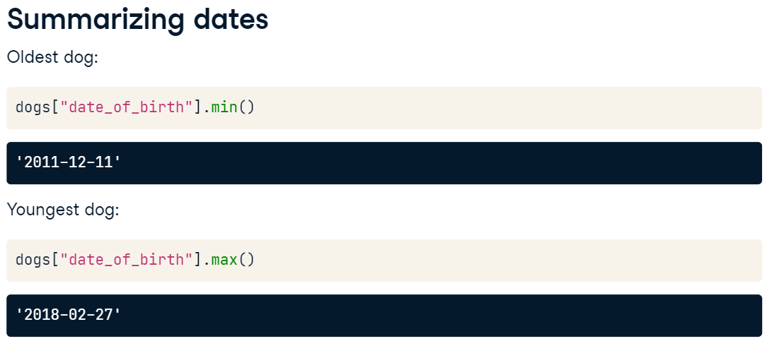
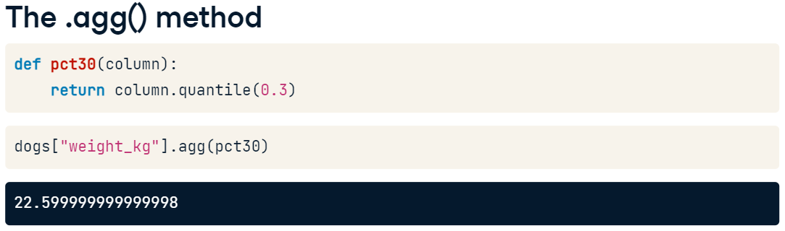
Basic Summary Statistics with Pandas
Writing your own function is also possible

Slide 16
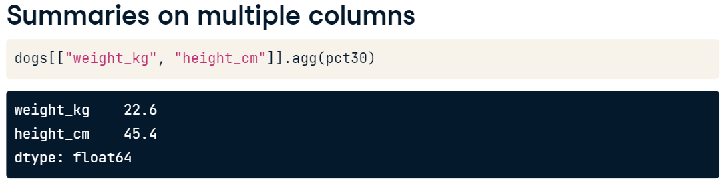
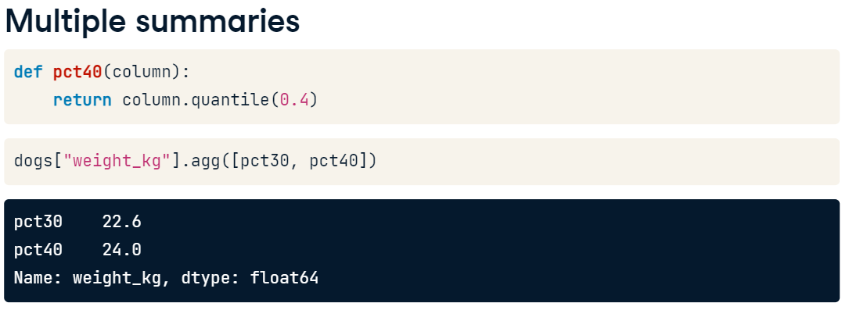
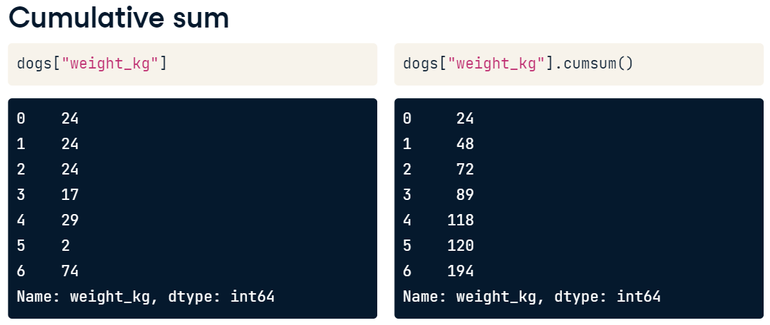

Slide 17
Summary Statistics (cont.)
Let’s see summary statistics in actions. Load sales_subset.csv to sales and try the following codes
# Print the head of the sales DataFrame
print(sales.head())
# Print the info about the sales DataFrame
print(sales.info())
# Print the mean of weekly_sales
print(sales['weekly_sales'].mean())
# Print the median of weekly_sales
print(sales['weekly_sales'].median())
# Print the maximum of the date column
print(sales['date'].max())
# Print the minimum of the date column
print(sales['date'].min())

Slide 18
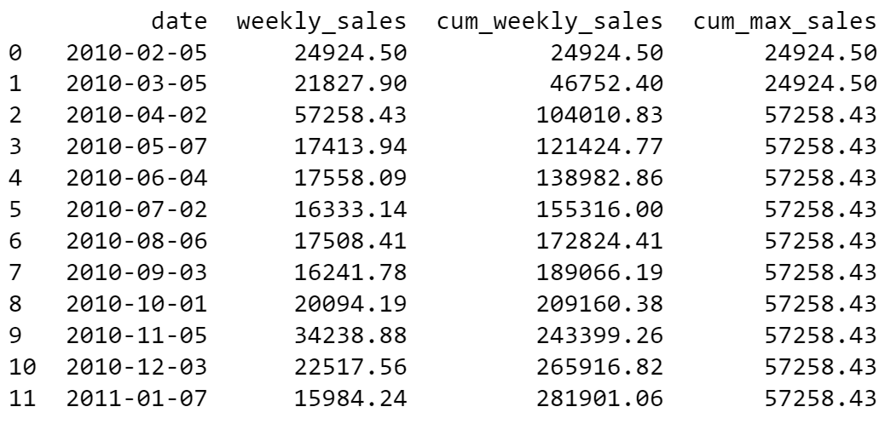
Create a DataFrame, sales_1_1, which contains the sales data for department 1 of store 1.
Hint: sales_1_1 = sales[(sales[‘deparment’] == ……) & (…………………) ]
Then try the following codes.
# Sort sales_1_1 by date
sales_1_1 = sales_1_1.sort_values('date', ascending = True)
# Get the cumulative sum of weekly_sales, add as cum_weekly_sales col
sales_1_1['cum_weekly_sales'] = sales['weekly_sales'].cumsum()
# Get the cumulative max of weekly_sales, add as cum_max_sales col
sales_1_1['cum_max_sales'] = sales['weekly_sales'].cummax()
# See the columns you calculated
print(sales_1_1[["date", "weekly_sales", "cum_weekly_sales", "cum_max_sales"]])

Slide 19
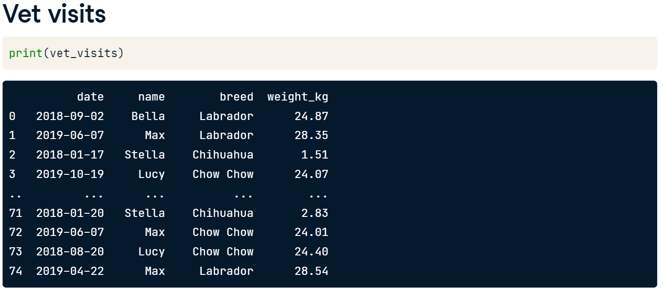
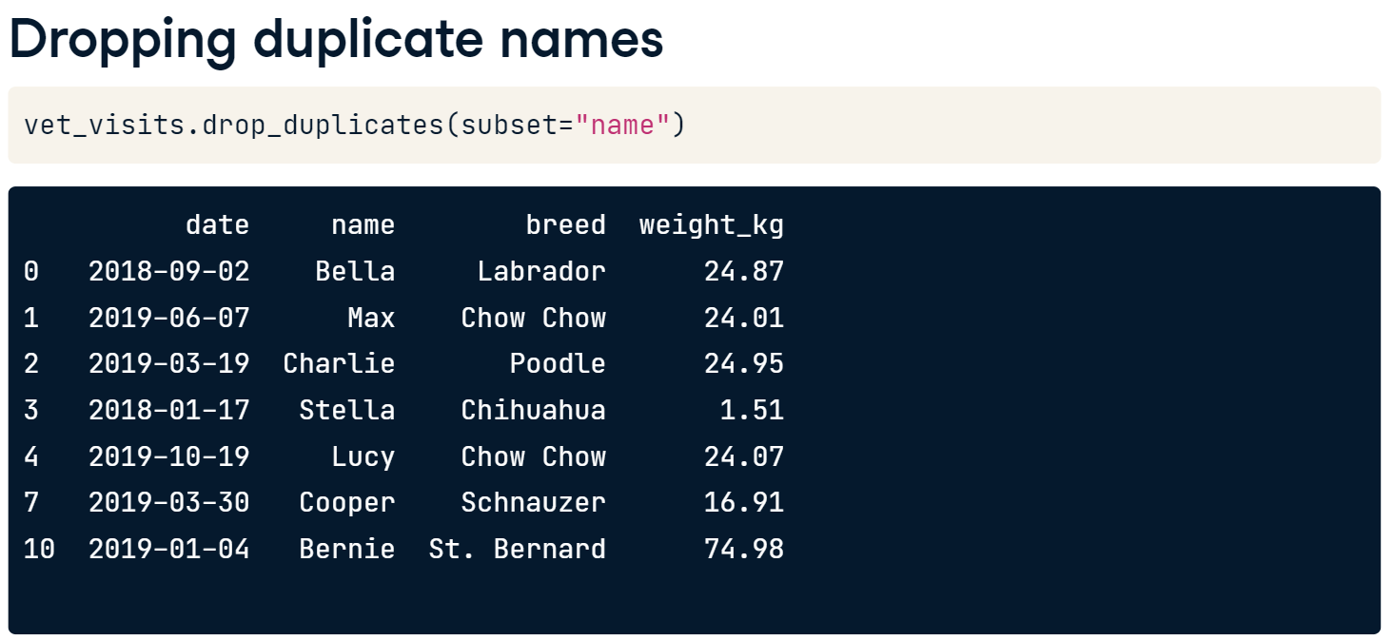
Dropping Duplicates
It is possible that the data set contains duplicated values and sometimes we do not want to have them in the analysis.

Slide 20
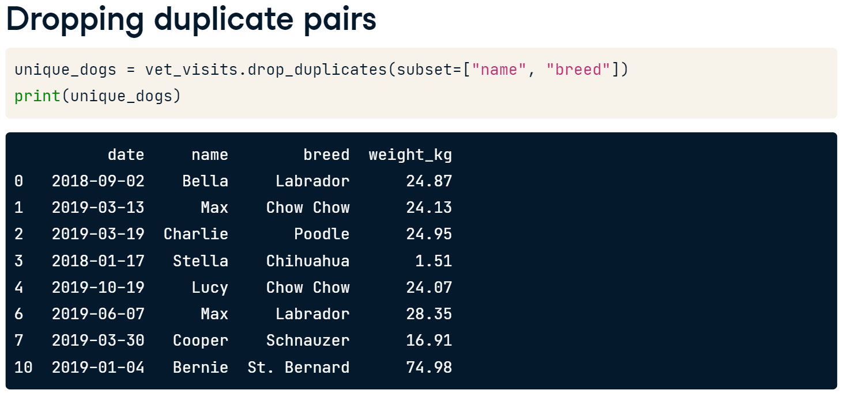
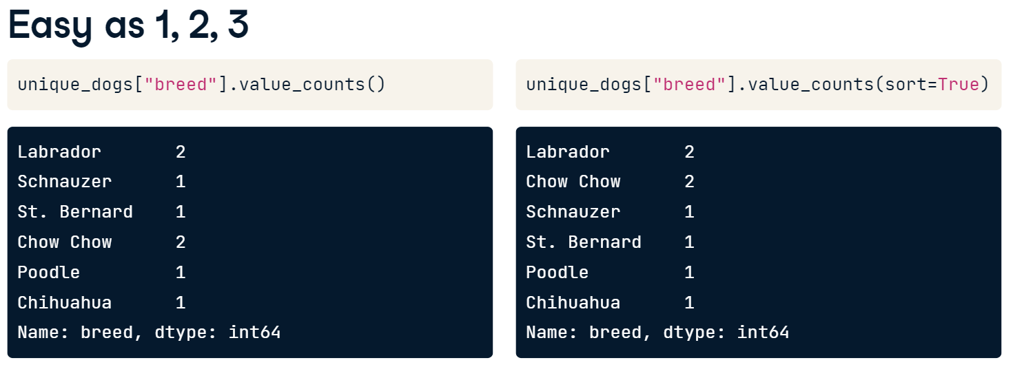
Since Max and Max are different breeds, we can drop the rows with pairs of name and breed listed earlier in the dataset.
After dropping duplicates, you may want to count the values.

Slide 21
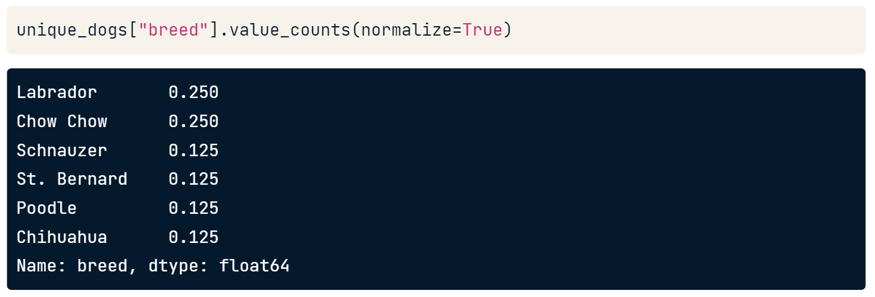
Normalization helps us to understand data better. The normalize argument can be used to turn the counts into proportions of the total. 25% of the dogs that go to this vet are Labradors.

Slide 22
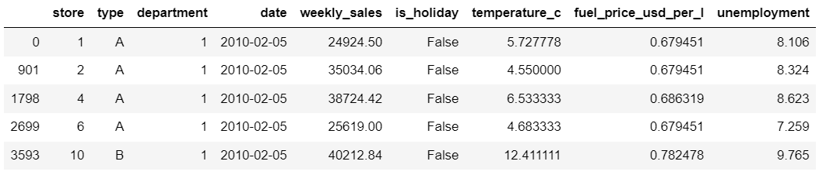
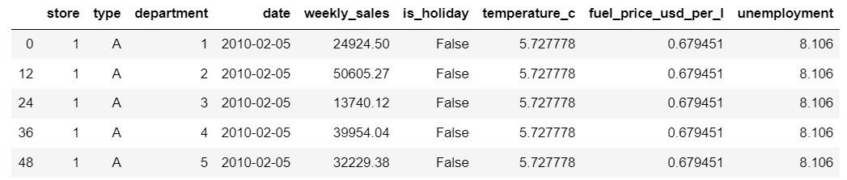
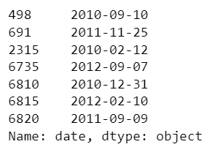
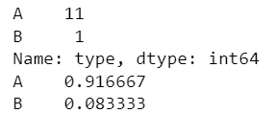
Let’s practice. Load sales_subset.csv to sales DataFrame
Dropping Duplicates
Remove rows of sales with duplicate pairs of store and type and save as store_types and print the head.
Remove rows of sales with duplicate pairs of store and department and save as store_depts and print the head.
Subset the rows that are holiday weeks using the is_holiday column, and drop the duplicate dates, saving as holiday_dates. Select the date column of holiday_dates, and print.
Counting and Normalization
Count the number of stores of each store type in store_types.
Count the proportion (normailization) of stores of each store type in store_types.
Count the number of different departments in store_depts, sorting the counts in descending order.
Count the proportion of different departments in store_depts, sorting the proportions in descending order.

Slide 23
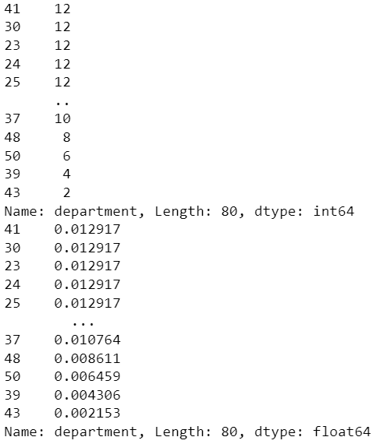

Slide 24
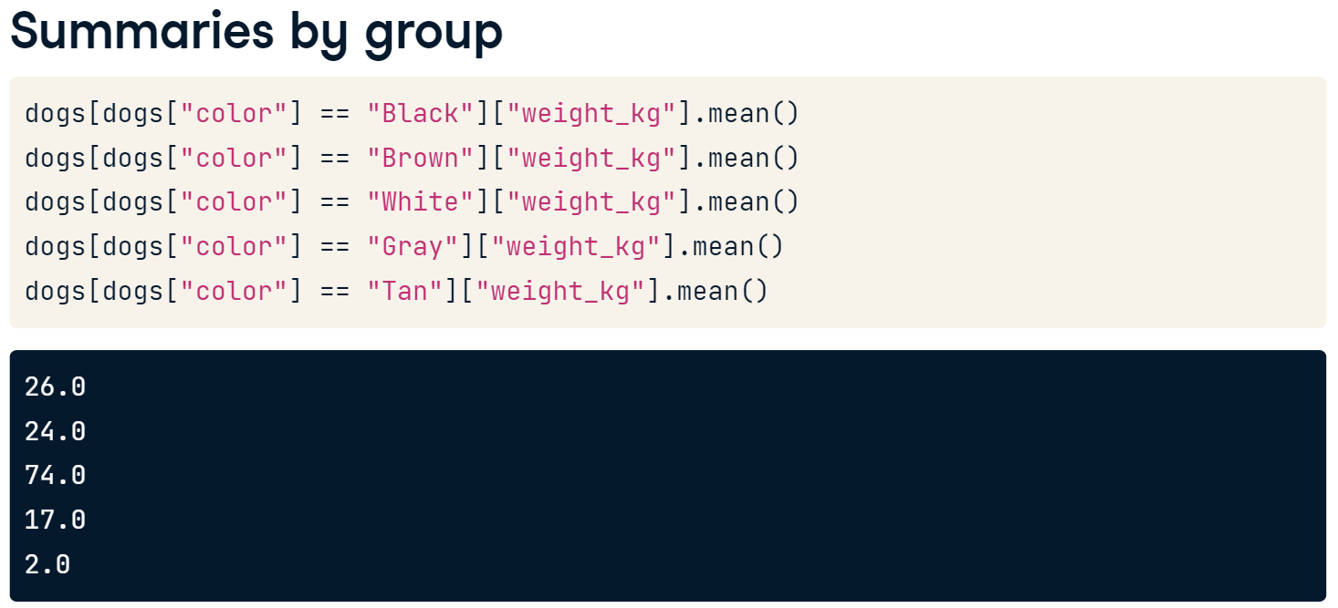
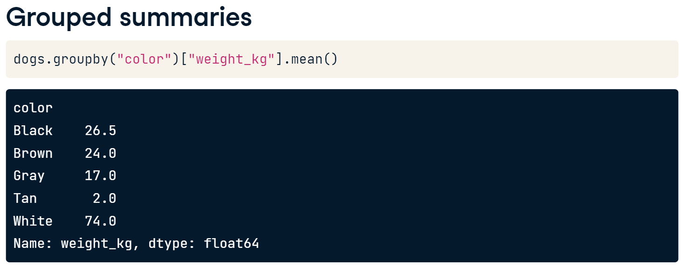
Summaries by Group

Slide 25
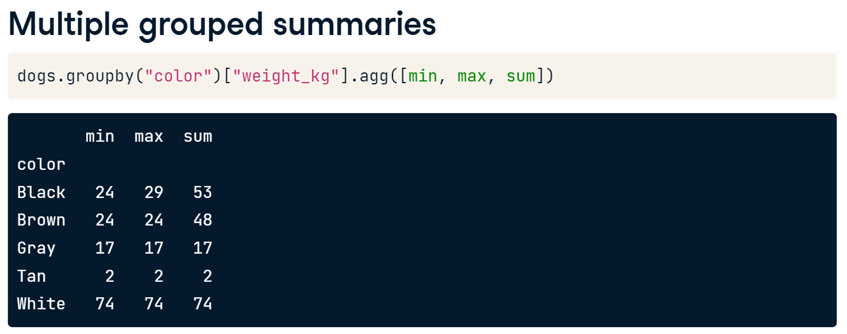
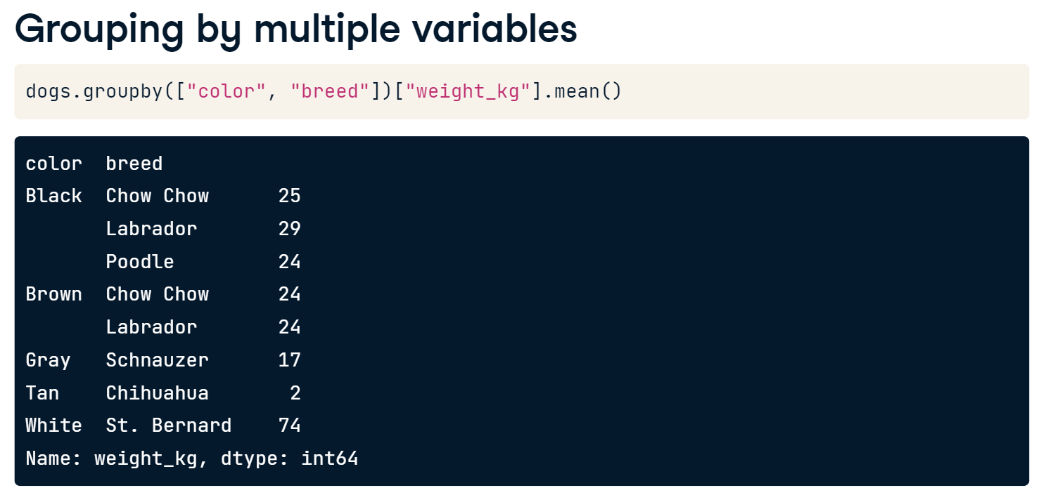

Slide 26
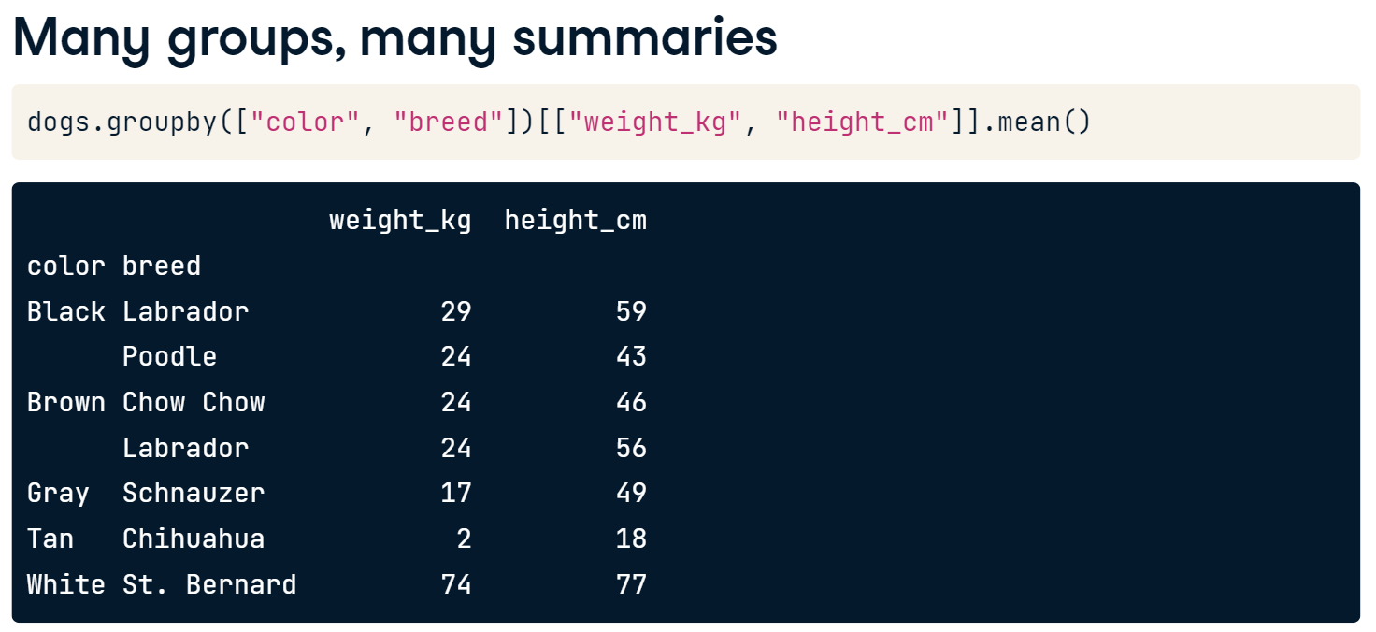

Slide 27
Let’s see how multiple grouped summaries work. Try the following codes.
# Calc total weekly sales
sales_all = sales["weekly_sales"].sum()
# Subset for type A stores, calc total weekly sales
sales_A = sales[sales["type"] == "A"]["weekly_sales"].sum()
# Subset for type B stores, calc total weekly sales
sales_B = sales[sales["type"] == "B"]["weekly_sales"].sum()
# Subset for type C stores, calc total weekly sales
sales_C = sales[sales["type"] == "C"]["weekly_sales"].sum()
# Get proportion for each type
sales_propn_by_type = [sales_A, sales_B, sales_C] / sales_all
print(sales_propn_by_type)

Slide 28
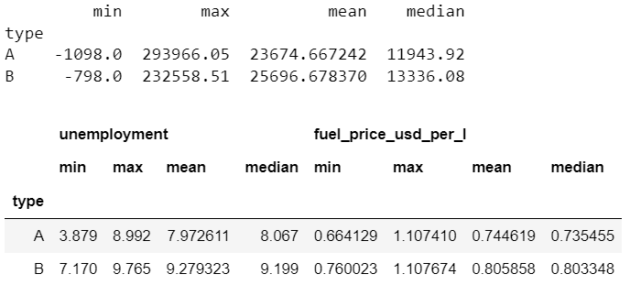
Now let’s try the following codes.
# Import numpy with the alias np
import numpy as np
# For each store type, aggregate weekly_sales: get min, max, mean, and median
sales_stats = sales.groupby('type')['weekly_sales'].agg([min, max, np.mean, np.median])
# Print sales_stats
print(sales_stats)
# For each store type, aggregate unemployment and fuel_price_usd_per_l: get min, max, mean, and median
unemp_fuel_stats = sales.groupby('type')[['unemployment','fuel_price_usd_per_l']].agg([min, max, np.mean, np.median])
# Print unemp_fuel_stats
print(unemp_fuel_stats)

Slide 29
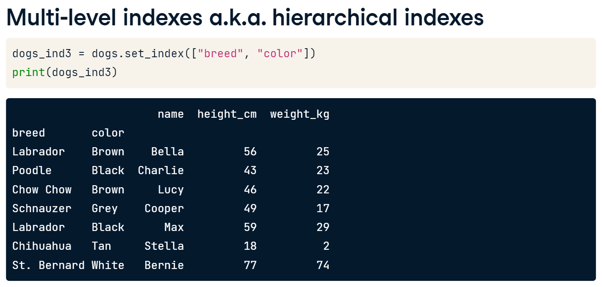
Multi-level Indexes (Hierarchical Indexes)

Slide 30
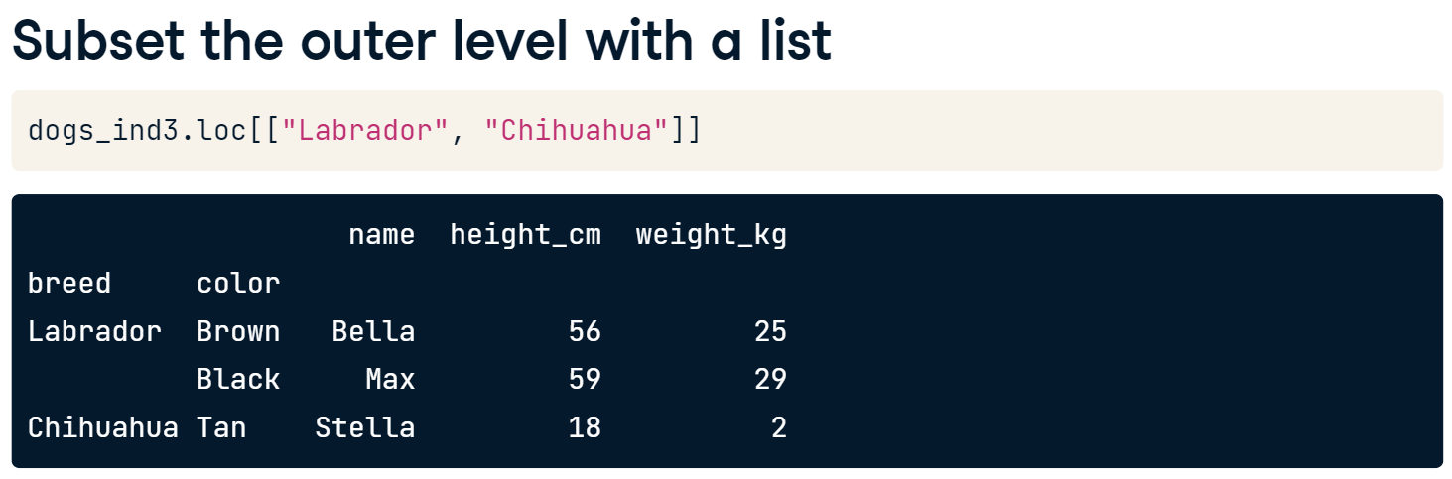
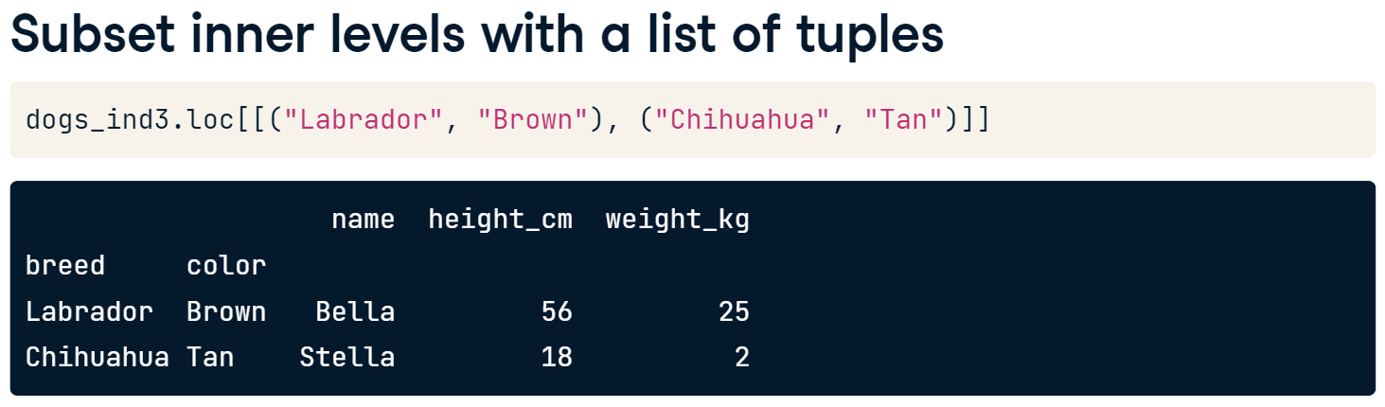

Slide 31
Let’s see some examples.
Load temperatures.csv to temperatures dataframe and try the following codes.
# Look at temperatures
print(temperatures)
# Set the index of temperatures to city
temperatures_ind = temperatures.set_index('city')
# Look at temperatures_ind
print(temperatures_ind)
# Reset the temperatures_ind index, keeping its contents
print(temperatures_ind.reset_index())
# Reset the temperatures_ind index, dropping its contents
print(temperatures_ind.reset_index(drop = True))
# Make a list of cities to subset on
cities = ["Moscow", "Saint Petersburg"]
# Subset temperatures using square brackets
print(temperatures[temperatures['city'].isin(cities)])
# Subset temperatures_ind using .loc[]
print(temperatures_ind.loc[cities])

Slide 32
Layering Plots
Let’s see what we can do if we have overlapping plots.
Load avoplotto.pkl (pickle file) to avocados dataframe and try the following.
# Import matplotlib.pyplot with alias plt
import matplotlib.pyplot as plt
# Look at the first few rows of data
print(avocados.head())
# Get the total number of avocados sold of each size
nb_sold_by_size = avocados.groupby('size')['nb_sold'].sum()
# Create a bar plot of the number of avocados sold by size
nb_sold_by_size.plot(kind = 'bar')
# Show the plot
plt.show()

Slide 33
# Get the total number of avocados sold on each date
nb_sold_by_date = avocados.groupby('date')['nb_sold'].sum()
# Create a line plot of the number of avocados sold by date
nb_sold_by_date.plot(kind='line', rot = 45)
# Show the plot
plt.show()
# Scatter plot of avg_price vs. nb_sold with title
avocados.plot(x='nb_sold', y='avg_price', kind = 'scatter', title = 'Number of avocados sold vs. average price')
# Show the plot
plt.show()

Slide 34

# Histogram of conventional avg_price
avocados[avocados['type'] == 'conventional']['avg_price'].plot(kind = 'hist')
# Histogram of organic avg_price
avocados[avocados['type'] == 'organic']['avg_price'].plot(kind = 'hist')
# Add a legend
plt.legend(['conventional','organic'])
# Show the plot
plt.show()
You can see a complete overlapped plots. The organic blocks the conventional plot.
Try add alpha = 0.6 in plot() and run again.

Slide 35


Missing Values in DataFrame
In a pandas DataFrame, missing values are indicated with N-a-N, which stands for "not a number.“

Slide 36


If we chain .isna() with .any(), we get one value for each variable that tells us if there are any missing values in that column.

Slide 37


Slide 38


One option is to remove the rows in the DataFrame that contain missing values. This can be done using the .dropna() method. However, this may not be ideal if you have a lot of missing data, since that means losing a lot of observations.

Slide 39
Import avocados_2016.csv to avocados dataframe and try the following codes.
# Check individual values for missing values
print(avocados_2016.isna())
# Check each column for missing values
print(avocados_2016.isna().any())
# Bar plot of missing values by variable
avocados_2016.isna().sum().plot(kind = 'bar')
# Show plot
plt.show()
# Remove rows with missing values
avocados_complete = avocados_2016.dropna()
# Check if any columns contain missing values
print(avocados_complete.isna().any())

Slide 40

From WorldBank_GDP.csv, answer the following questions.
Which country’s GDP is growing during the Year 2010 and Year 2018? Support your answer with visualizations.
From temperatures.csv, answer the following questions.
Find out which country has the highest average temperature.
Find out how many countries where the average temperature is in the range of 20 and 30 Celsius. Show all the countries and their average temperature.
Show the average temperature of Thailand during 2005-01-01 and 2010-01-01 and also find the average temperature during that period.

